Slide 1

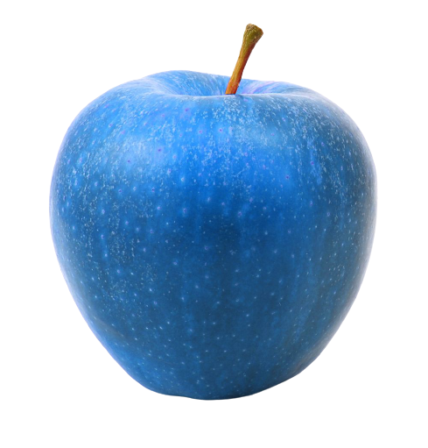
Impact of Education on Students’ health
-“Being healthy is not a goal, it’s a way of living.”
-Firoza(19-5M3)
-Gayathri(19-5P1)
-Vandana(19-5P7)
-Greeshma(19-5P9)
-Harshita(19-5K9)

Slide 2

Why this problem statement?
Creative and imaginative students
Students lacking physical fitness
Stressful and unhealthy students
In order to achieve higher goals or fulfill their dreams, it’s more important to have a healthier state of mind and body because no wealth would buy health and happiness. So not just mere education but also proper care of health should be taken.

Slide 3

What did we do and Analyse?
Primary survey
Secondary survey
From the primary survey, we came to know that many students are facing health issues due to stress.
After going through several articles and papers, we’ve got an idea about the actual scenario
Data study
Gap Analysis
In the present world, not much priority to health is given as given to education. In the future ,there must be a proper balance between health and education.
Databases
Research Papers

Slide 4
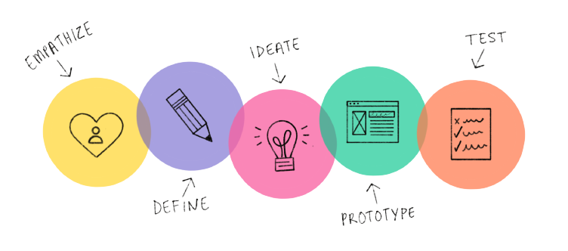
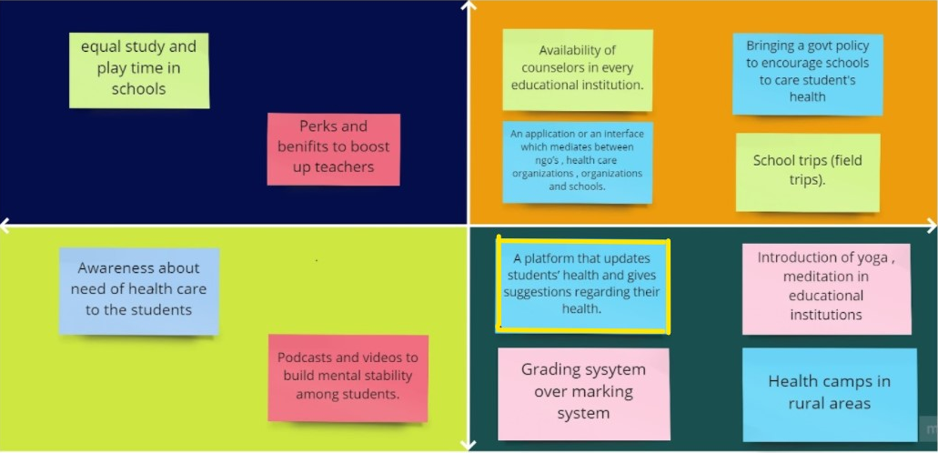
Phases
Empathise
Define
Ideate
Student’s Mindset
Empathy map
2*2 matrix
Low Efficiency High
Point of view
How might we?
Easy Implementation Hard
Mindmap
2x2 matrix

Slide 5
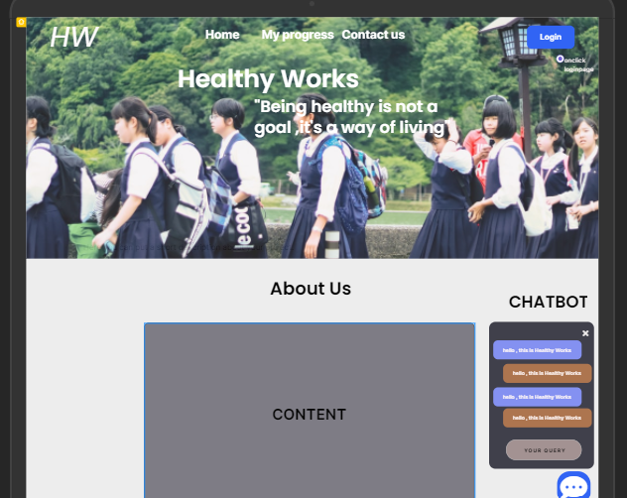
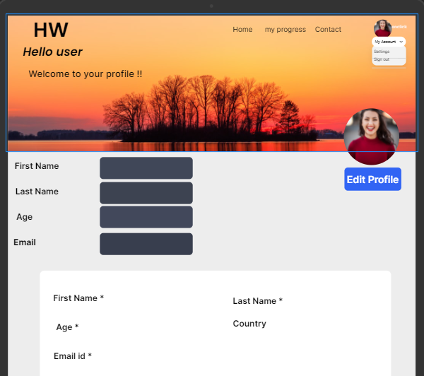


Idea selected
Wireframes
Video
A platform that updates students’ health and gives suggestions regarding their health.
Prototype Design

Slide 6

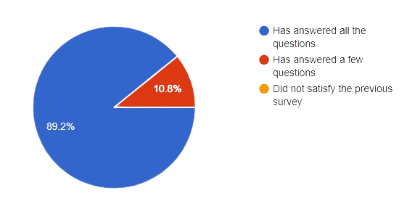
Implementation
Testing
Website
We have tested our prototype by collecting various responses through google forms from secondary school students about how are idea actually is !

Slide 7

Conclusions
Developed a website to cheer up students and give health suggestions accordingly.
Stress among students is the most pressing issue which has to be addressed in today’s society.
After testing the prototype, we felt many students are happy with our idea and are willing to make the best use of it !
Have tried our best to come up with this solution to solve a major issue faced by many students and hoping that our idea would be successful and help students to the maximum extent.

